Slide 1
Lab 1 Preview
Learn to read, write & play audio files on the computer
Apply what you learned about going from CT to DT
Implement amplitude & time operations on signals

Slide 2
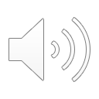
Lab 1: Audio Time Scaling
Music sample:
x[n] x[-n]
Speech sample
w[n] w[-n]
Time scaling w[2n] w[n/2]
Yawn
y[n] y[-n]
Time scale [y[n] y[3n/4] y[2n/3] y[n/2] y[2n]]

